Slide 1
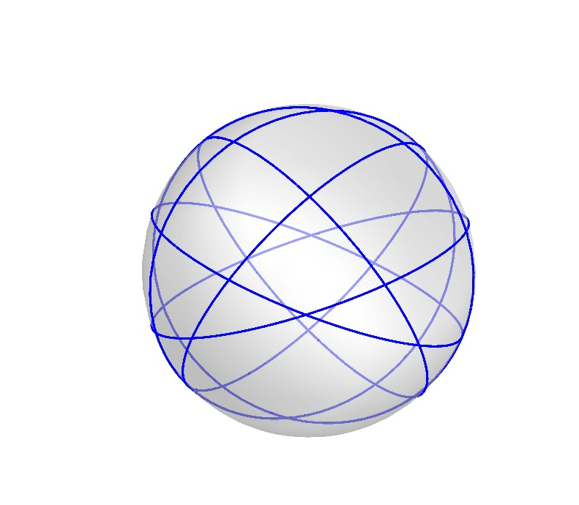
Great Circles Problem
Kha Man

Slide 2
Recent news
I generated 1000 graphs for each 6,7,8 great circles.
6 great circles: have 4 non-isomorphic graphs.
7 great circles: have 11 non-isomorphic graphs.
8 great circles: have 114 non-isomorphic graphs.
My previous idea only worked for the graphs consist of quadrilaterals and triangles. Therefore, mostly it doesn’t work for all possible non-isomorphic graphs.

Slide 3
Observation
I am going to show all the non-isomorphic graphs of 1000 graphs with 6 and 7 graphs because it has small amounts enough to see the symmetry
The planar embedding is plotted out by GraphLayout-> “TutteEmbedding” (Wikipedia) (Mathematica)

Slide 4
Observation
We already knew that the center of the sphere is the point symmetry. Luckily, when 2 intersections were made by a pair of 2 great circles, I named it 2 consecutive integers, where the odd is the 1st one. It means when you see 10, its duplication in term of other intersection by the same 2 great circles is 9.
This feature is extremely beneficial when finding a duplicate of a shape in the planar embedding of graph. For example, I found a triangle containing the vertex 3; then obviously I will see another triangle containing the vertex 4 which is intersected by 2 same great circles with vertex 3
We may see there are some graphs that have symmetry reflection via the middle of the graph but sometimes it’s not correct. I recommend the rule above to keep tracking the duplications.

Slide 5
Non-isomorphic graphs made by 6 great circles

Slide 6
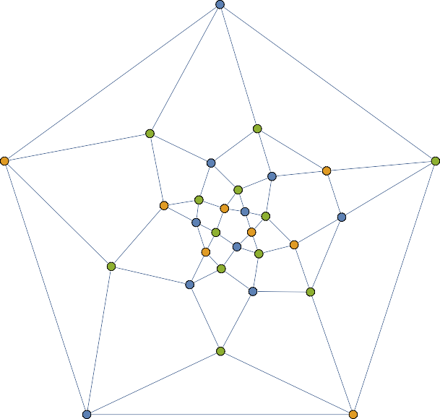
1
7
11
15
21
9
17
23
29
6
20
27
25 ₁₃
3
4
10 16
5
24
2
8
14
12
18
22
19
30
26
28

Slide 7
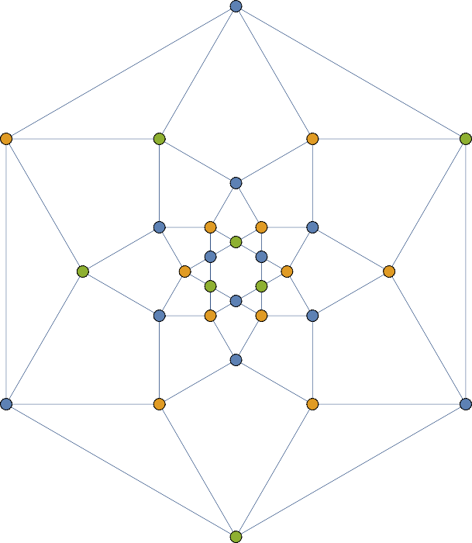
3
8
22
5
19
26
24
28 15
1
18
10
12
14 29
20 7
4
9
11
2
6 21
23
25
30
16
27
13
17

Slide 8
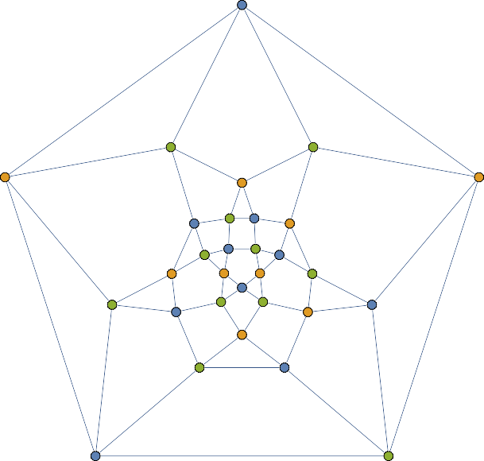
1
7
11
15
21
3
9
24 30
18
₆ 20 26 ₁₄
4 16
2
12 8
27
28
13
17
10
5
22
29
23
25

Slide 9
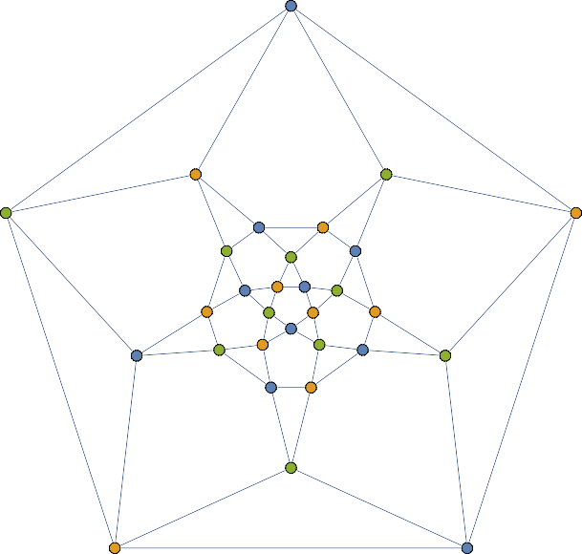
1
9
11
17
3
29 21
7
23
15
₅ 19 27 ₁₄
4 18
2
12 10
25
26
13
16
8
6
22 30
24
28

Slide 10
Non-isomorphic graphs made by 7 great circles

Slide 11
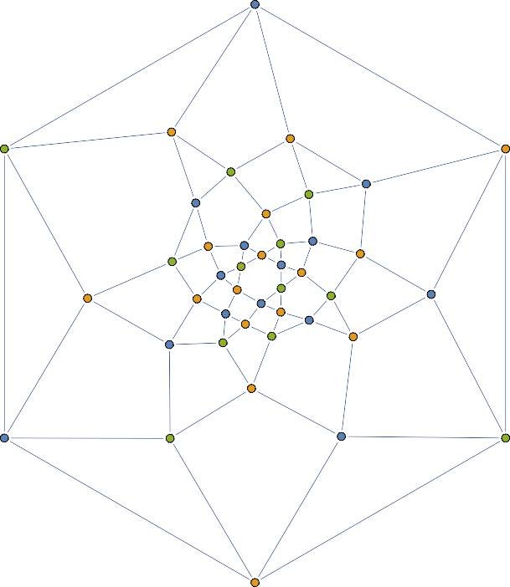
5
3
15
24
8
13
17
1
31
25
9
37
29
35
19
41
27
22
11
39
33
34
21
7
23
20
12
18
6
4
16
2
36
32
14
10
26
28
30
38
40
42

Slide 12
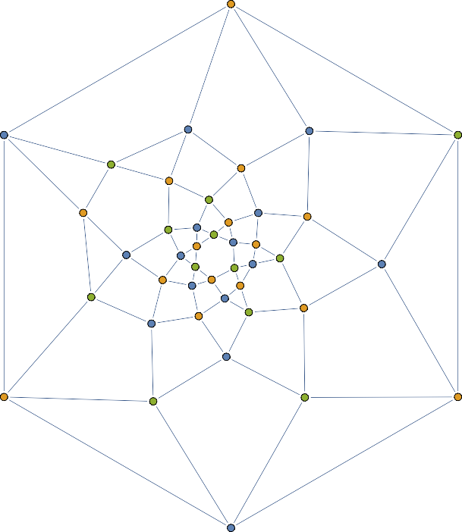
5
31
3
33
9
25
27
7
38
23
18
14
16
12
42
22
20
40
30
35
2
₃₂ 24
26
36
1
10
15
34
6
29
4
11
28
8
13
37
39
17
41
19
21

Slide 13
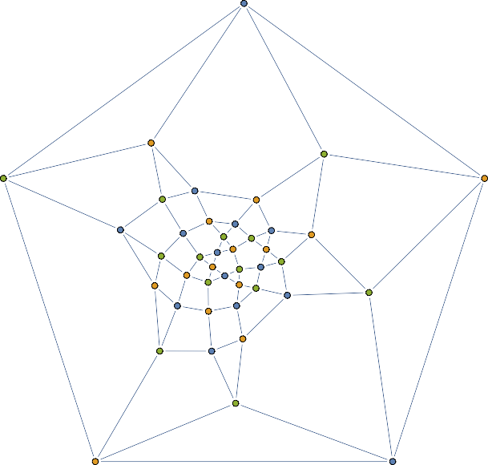
1
7
15
17
5
10
38
33
20
26
24
41
4
32 29
21
14
12
₃₆ 40 27
6
16
18 ¹⁹
8 ₉
37
13
22
2
28
3
11
42
34
25
30
23
31
39
35

Slide 14
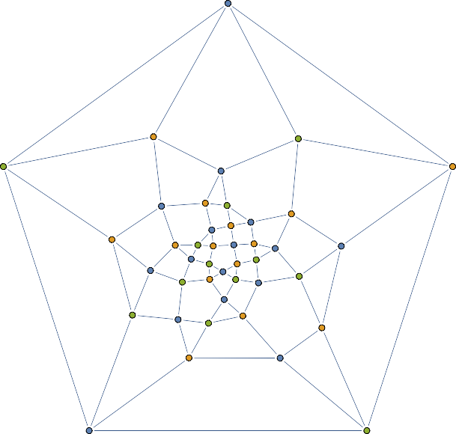
1
3
15
13
24
5
8
32 ₂₆
40
21
₃₆ 30
18
10 42 34 28 ³⁷ ₁₉
11
12 17
20
6 14
2
16 4
22
7
9
23
38
39
25
31
41
29
35
27
33

Slide 15
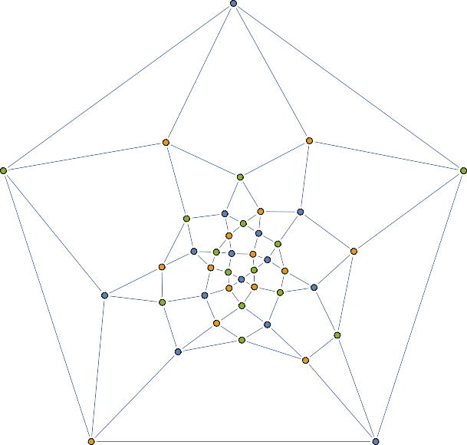
1
9
17
19
37
8
11
39
34
16
35
31
42
3
²³ 25 28
22
6
29
5 ₇
18
14
2
20
30
13
15
10
12
4
21
38
33
40
36
24
41
32
27
26

Slide 16
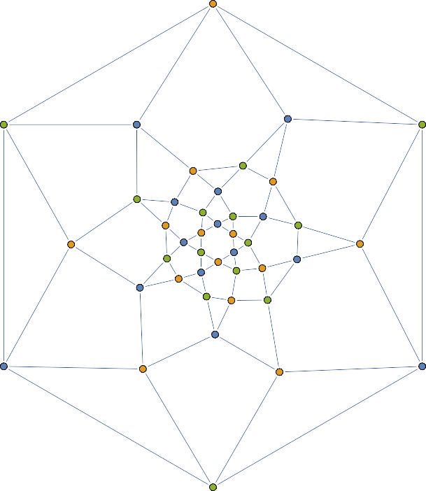
5
9
33
3
23
42
30
28
11
31
40
26
20
1
36
14
18
38
21
7
16
24
10
8
15
22
6
32
35
12
4
34
2
29
41
39
27
37
19
25
13
17

Slide 17
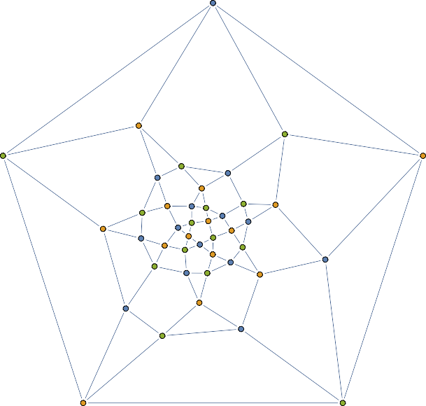
1
11
17
21
29
7
4
25
39
28
10
³⁸ 42
23 15
32 ³⁶
33
13
20
14
6
⁸ 22
19
16
18
2
12
27
24
3
5
26 30
9
34
40
41
37
35

Slide 18
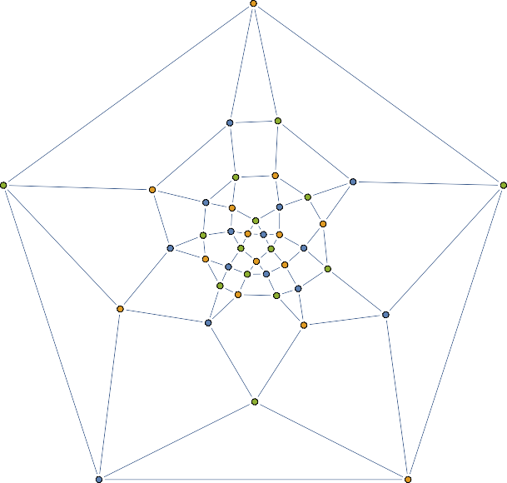
3
1
13
28
11
29
17
7
20
41
39
9 25
37
⁵ 31 33 23
8 27
35
21
16
22
15
18
4
14 2
19
36
40
30
12
42
24
6
26
10
38
34

Slide 19
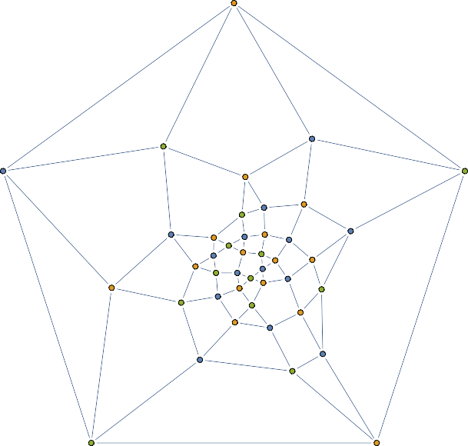
5
35
1
11
22
15
42
9
20
24
28
₁₈ 40
¹⁴ 30
8
33
26
38
4
31
32
34 16
2
12
⁶ 36
3
23
10
37
7
21
27
41
19
39
25
17
29
13

Slide 20
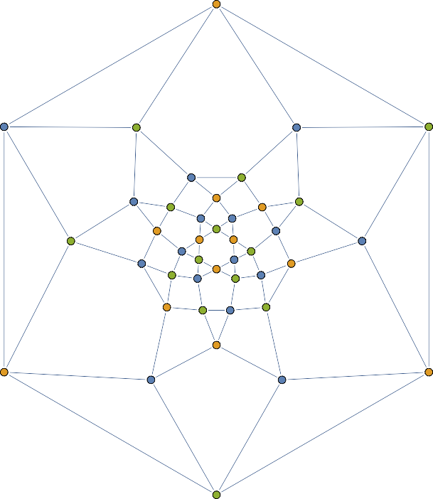
13
19
27
17
25
9
7
29
11
37
5
15
40
36
34
21
4
32
42
1
23
24
26
20
22
2
14
3
16
18
28
30
6
8
10
12
38
41
33
39
31
35

Slide 21
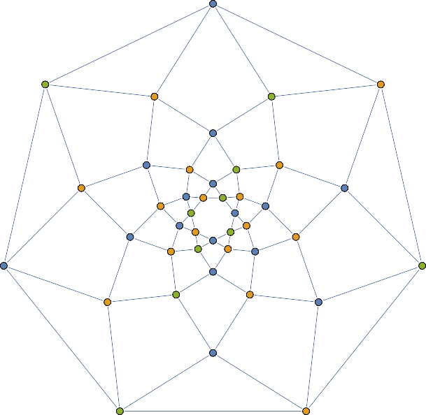
1
19
12
9
22
41
7
39 28
26
35 23 32 34
29 38
14
17
4
5
16
3
11 20
18
15
2
6
13
21 10
8
37
42
30
33
27
40
36
25
31
24

Slide 22
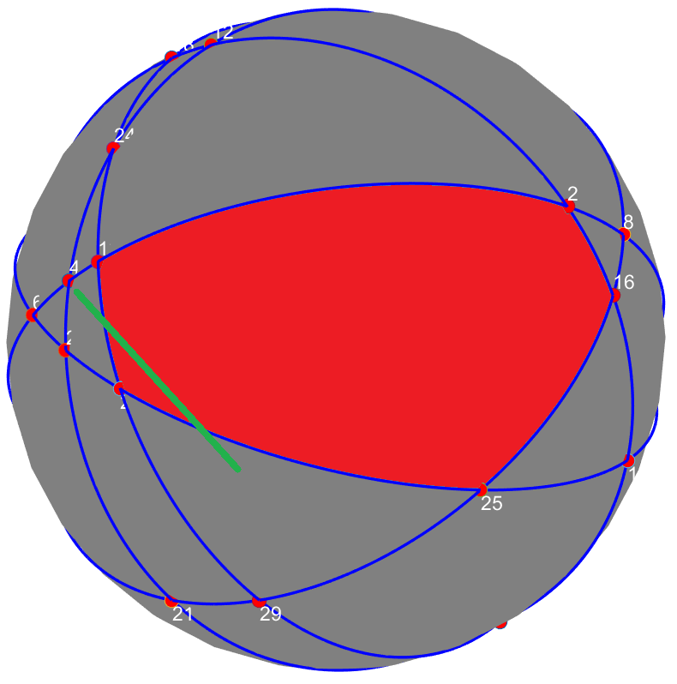
1 Conclusion
This line can make the the red pentagonal be a hexagonal
How many types of polygons can be made in this problem?
There is no limit for this since if I’m having a polygon bounded by the greatest finite chain of straight line segments, I can add 1 additional great circle to build a polygon that is bounded by (the greatest finite chain of straight line segments + 1)

